Slide 1
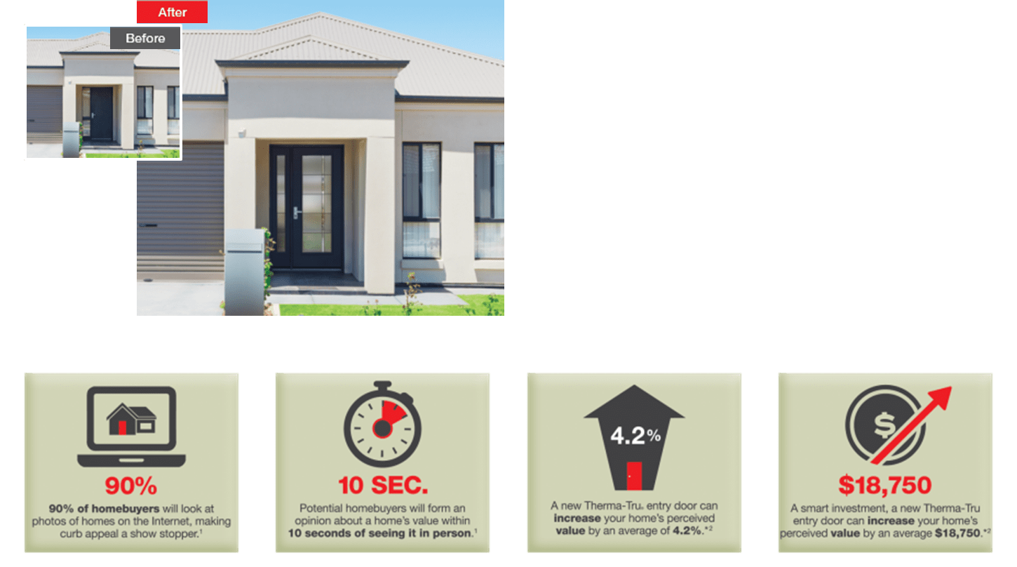
Your Logo Here
www.thermatru.com
The Power of CURB APPEAL.
Entry & Patio Door Systems Presented By
(Name) John Builder | (Phone) XXX-XXX-XXXX | (Email) builder@buildername.com | (Web) www.buildername.com
What DIFFERENCE does a DOOR make? Without strong curb appeal, you could be missing out.
A stylish new Therma-Tru® entry door can INCREASE a home’s perceived VALUE by 4.2% or $18,750 on average.*
¹www.about.com ²www.theramtru.com
*Based on a nationwide survey of consumers’ estimates of perceived home value based on exterior appearance. Not based on actual home sales. Results may vary based on region and home style.
Therma-Tru’s “National Home Valuation Study” was commissioned by Therma-Tru in 2015 and conducted by TNS, an independent provider of Internet-based research. ©2017 Therma-Tru Corp. All rights reserved.

Slide 2
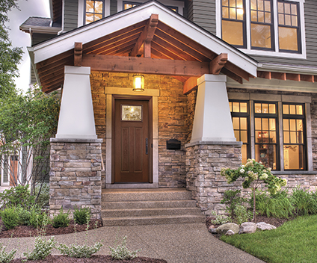
Your Logo Here
www.thermatru.com
Therma-Tru. You’re in Expert Hands.
Backed by our lifetime limited warranty.
Lifetime Limited Warranty
We stand behind more parts of a door system for longer than other door companies because we make or specify everything that goes into it. A Therma-Tru fiberglass door system is backed by the industry’s most comprehensive lifetime limited warranty.
Energy Efficiency
In any region or climate, energy efficiency is key. Thousands of Therma-Tru door and glass options are ENERGY STAR® qualified and National Fenestration Rating Council (NFRC) certified, helping save money on energy costs.
Quality Testing
Our doors, glass and components are held to high standards. We conduct thorough testing to guarantee that our products will live up to a homeowner’s toughest quality and performance expectations.
Right click – Open Hyperlink:
Insert picture of builder's home or choose from Therma-Tru's beauty shots here.
(Name) John Builder | (Phone) XXX-XXX-XXXX | (Email) builder@buildername.com | (Web) www.buildername.com
Note: See your Therma-Tru seller or visit www.thermatru.com for details on available product sizes and options, limited warranties and exclusions, and ENERGY STAR qualified products. ©2017 Therma-Tru Corp. All rights reserved. ENERGY STAR is a government program that helps consumers protect the environment through superior energy efficiency and is a registered trademark of the U.S. Department of Energy and the U.S. Environmental Protection Agency.

Slide 3
Your Logo Here
www.thermatru.com
Headline
Subhead
Door Family Door / Glass Description
Caming
6'8" / 8'0" Door – Style #
Note: Product images show exterior side of door. Colors may vary from an actual application due to fluctuations in finishing. Glass privacy ratings may be more or less than indicated, based on glass design and size of glass. Glass designs may differ from depiction due to handcrafting and size of glass. See your Therma-Tru seller or visit www.thermatru.com for details on limited warranties and exclusions, glass privacy ratings and designs, and ENERGY STAR® qualified products. ©2017 Therma-Tru Corp. All rights reserved. ENERGY STAR is a government program that helps consumers protect the environment through superior energy efficiency and is a registered trademark of the U.S. Department of Energy and the U.S. Environmental Protection Agency.
Fiberglass

Slide 4
Your Logo Here
www.thermatru.com
Headline
Subhead
Door Family Door / Glass Description
Caming
6'8" / 8'0" Door – Style #
Door Family Door / Glass Description
Caming
6'8" / 8'0" Door – Style #
Door Family Door / Glass Description
Caming
6'8" / 8'0" Door – Style #
Note: Product images show exterior side of door. Colors may vary from an actual application due to fluctuations in finishing. Glass privacy ratings may be more or less than indicated, based on glass design and size of glass. Glass designs may differ from depiction due to handcrafting and size of glass. See your Therma-Tru seller or visit www.thermatru.com for details on limited warranties and exclusions, glass privacy ratings and designs, and ENERGY STAR® qualified products. ©2017 Therma-Tru Corp. All rights reserved. ENERGY STAR is a government program that helps consumers protect the environment through superior energy efficiency and is a registered trademark of the U.S. Department of Energy and the U.S. Environmental Protection Agency.
Fiberglass

Slide 5
Your Logo Here
www.thermatru.com
Headline
Subhead
Door Family Door / Glass Description
Caming
6'8" / 8'0" Door – Style #
Door Family Door / Glass Description
Caming
6'8" / 8'0" Door – Style #
Door Family Door / Glass Description
Caming
6'8" / 8'0" Door – Style #
Door Family Door / Glass Description
Caming
6'8" / 8'0" Door – Style #
Door Family Door / Glass Description
Caming
6'8" / 8'0" Door – Style #
Door Family Door / Glass Description
Caming
6'8" / 8'0" Door – Style #
Note: Product images show exterior side of door. Colors may vary from an actual application due to fluctuations in finishing. Glass privacy ratings may be more or less than indicated, based on glass design and size of glass. Glass designs may differ from depiction due to handcrafting and size of glass. See your Therma-Tru seller or visit www.thermatru.com for details on limited warranties and exclusions, glass privacy ratings and designs, and ENERGY STAR® qualified products. ©2017 Therma-Tru Corp. All rights reserved. ENERGY STAR is a government program that helps consumers protect the environment through superior energy efficiency and is a registered trademark of the U.S. Department of Energy and the U.S. Environmental Protection Agency.
Fiberglass

Slide 6
Your Logo Here
www.thermatru.com
Classic-Craft® Collection
Subhead
Door Family Door / Glass Description
Caming
6'8" / 8'0" Door – Style #
Note: Product images show exterior side of door. Colors may vary from an actual application due to fluctuations in finishing. Glass privacy ratings may be more or less than indicated, based on glass design and size of glass. Glass designs may differ from depiction due to handcrafting and size of glass. See your Therma-Tru seller or visit www.thermatru.com for details on limited warranties and exclusions, glass privacy ratings and designs, and ENERGY STAR® qualified products. ©2017 Therma-Tru Corp. All rights reserved. ENERGY STAR is a government program that helps consumers protect the environment through superior energy efficiency and is a registered trademark of the U.S. Department of Energy and the U.S. Environmental Protection Agency.
Fiberglass

Slide 7
Your Logo Here
www.thermatru.com
Classic-Craft® Collection
Subhead
Door Family Door / Glass Description
Caming
6'8" / 8'0" Door – Style #
Door Family Door / Glass Description
Caming
6'8" / 8'0" Door – Style #
Door Family Door / Glass Description
Caming
6'8" / 8'0" Door – Style #
Note: Product images show exterior side of door. Colors may vary from an actual application due to fluctuations in finishing. Glass privacy ratings may be more or less than indicated, based on glass design and size of glass. Glass designs may differ from depiction due to handcrafting and size of glass. See your Therma-Tru seller or visit www.thermatru.com for details on limited warranties and exclusions, glass privacy ratings and designs, and ENERGY STAR® qualified products. ©2017 Therma-Tru Corp. All rights reserved. ENERGY STAR is a government program that helps consumers protect the environment through superior energy efficiency and is a registered trademark of the U.S. Department of Energy and the U.S. Environmental Protection Agency.
Fiberglass

Slide 8
Your Logo Here
www.thermatru.com
Classic-Craft® Collection
Subhead
Door Family Door / Glass Description
Caming
6'8" / 8'0" Door – Style #
Door Family Door / Glass Description
Caming
6'8" / 8'0" Door – Style #
Door Family Door / Glass Description
Caming
6'8" / 8'0" Door – Style #
Door Family Door / Glass Description
Caming
6'8" / 8'0" Door – Style #
Door Family Door / Glass Description
Caming
6'8" / 8'0" Door – Style #
Door Family Door / Glass Description
Caming
6'8" / 8'0" Door – Style #
Note: Product images show exterior side of door. Colors may vary from an actual application due to fluctuations in finishing. Glass privacy ratings may be more or less than indicated, based on glass design and size of glass. Glass designs may differ from depiction due to handcrafting and size of glass. See your Therma-Tru seller or visit www.thermatru.com for details on limited warranties and exclusions, glass privacy ratings and designs, and ENERGY STAR® qualified products. ©2017 Therma-Tru Corp. All rights reserved. ENERGY STAR is a government program that helps consumers protect the environment through superior energy efficiency and is a registered trademark of the U.S. Department of Energy and the U.S. Environmental Protection Agency.
Fiberglass

Slide 9
Your Logo Here
www.thermatru.com
Fiber-Classic® / Smooth-Star®
Subhead
Door Family Door / Glass Description
Caming
6'8" / 8'0" Door – Style #
Note: Product images show exterior side of door. Colors may vary from an actual application due to fluctuations in finishing. Glass privacy ratings may be more or less than indicated, based on glass design and size of glass. Glass designs may differ from depiction due to handcrafting and size of glass. See your Therma-Tru seller or visit www.thermatru.com for details on limited warranties and exclusions, glass privacy ratings and designs, and ENERGY STAR® qualified products. ©2017 Therma-Tru Corp. All rights reserved. ENERGY STAR is a government program that helps consumers protect the environment through superior energy efficiency and is a registered trademark of the U.S. Department of Energy and the U.S. Environmental Protection Agency.
Fiberglass

Slide 10
Your Logo Here
www.thermatru.com
Fiber-Classic® / Smooth-Star®
Subhead
Door Family Door / Glass Description
Caming
6'8" / 8'0" Door – Style #
Door Family Door / Glass Description
Caming
6'8" / 8'0" Door – Style #
Door Family Door / Glass Description
Caming
6'8" / 8'0" Door – Style #
Note: Product images show exterior side of door. Colors may vary from an actual application due to fluctuations in finishing. Glass privacy ratings may be more or less than indicated, based on glass design and size of glass. Glass designs may differ from depiction due to handcrafting and size of glass. See your Therma-Tru seller or visit www.thermatru.com for details on limited warranties and exclusions, glass privacy ratings and designs, and ENERGY STAR® qualified products. ©2017 Therma-Tru Corp. All rights reserved. ENERGY STAR is a government program that helps consumers protect the environment through superior energy efficiency and is a registered trademark of the U.S. Department of Energy and the U.S. Environmental Protection Agency.
Fiberglass

Slide 11
Your Logo Here
www.thermatru.com
Fiber-Classic® / Smooth-Star®
Subhead
Door Family Door / Glass Description
Caming
6'8" / 8'0" Door – Style #
Door Family Door / Glass Description
Caming
6'8" / 8'0" Door – Style #
Door Family Door / Glass Description
Caming
6'8" / 8'0" Door – Style #
Door Family Door / Glass Description
Caming
6'8" / 8'0" Door – Style #
Door Family Door / Glass Description
Caming
6'8" / 8'0" Door – Style #
Door Family Door / Glass Description
Caming
6'8" / 8'0" Door – Style #
Note: Product images show exterior side of door. Colors may vary from an actual application due to fluctuations in finishing. Glass privacy ratings may be more or less than indicated, based on glass design and size of glass. Glass designs may differ from depiction due to handcrafting and size of glass. See your Therma-Tru seller or visit www.thermatru.com for details on limited warranties and exclusions, glass privacy ratings and designs, and ENERGY STAR® qualified products. ©2017 Therma-Tru Corp. All rights reserved. ENERGY STAR is a government program that helps consumers protect the environment through superior energy efficiency and is a registered trademark of the U.S. Department of Energy and the U.S. Environmental Protection Agency.
Fiberglass

