Slide 1


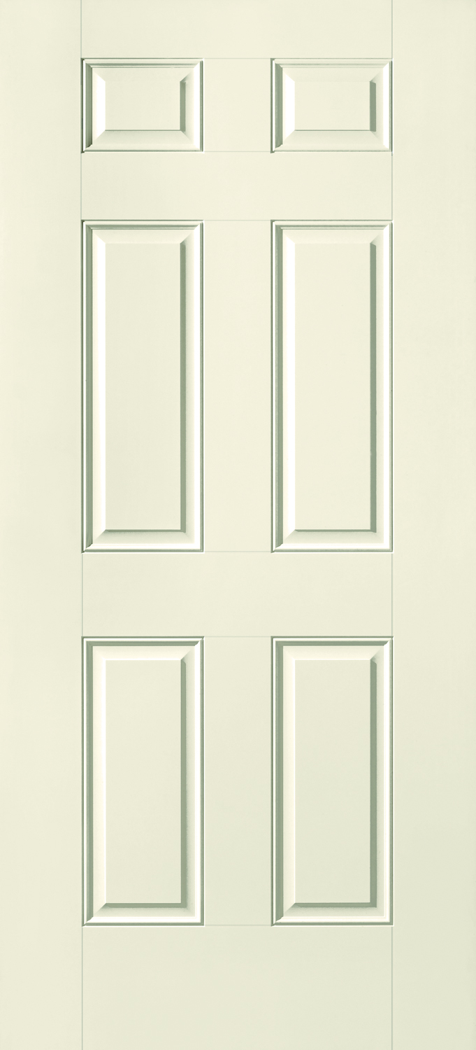

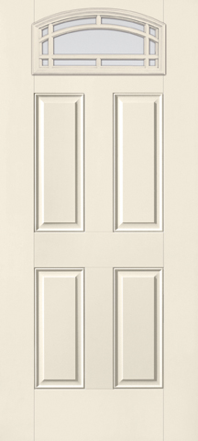

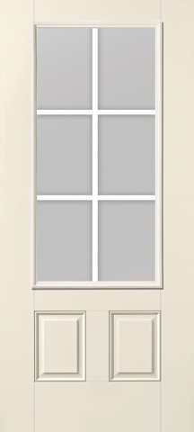

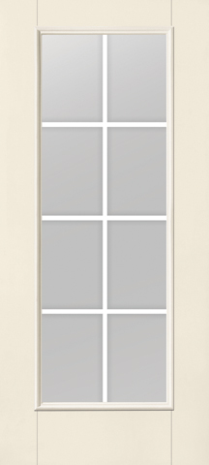
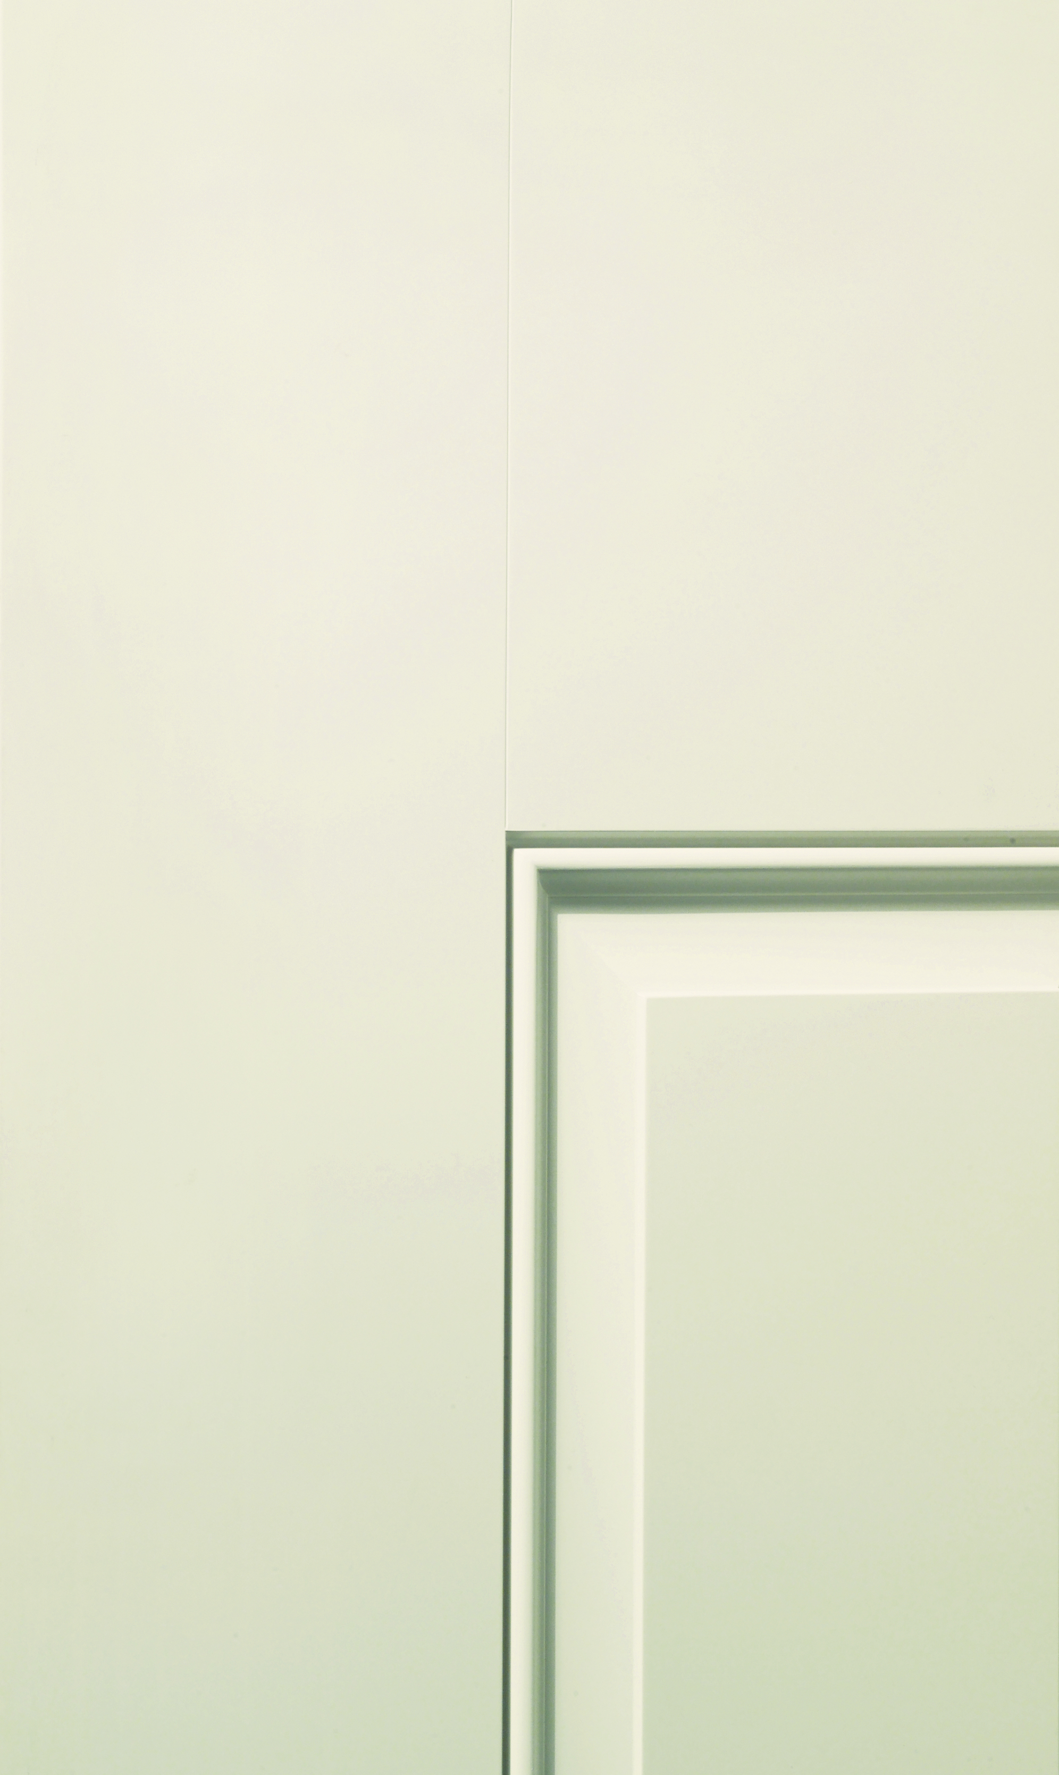

Your Logo Here
Standard Front Entry Door & Upgrade Options
Smooth-Star® Paintable Fiberglass
Solid 6-Panel Door
6'8" Door w/ 14" Sidelites
Door: S210; Sidelites: S308SL
Clear Glass with Fixed Grilles
6'8" Door w/ 14" Sidelites
Door: S704; Sidelites: S210SL
Clear Glass with Grilles Between Glass
6'8" Door w/ 14" Sidelites
Door: S2107; Sidelites: S2101SL
Clear Glass with Grilles Between Glass
6'8" Door w/ 14" Sidelites
Door: S1212; Sidelites: S1208SL
Smooth-Star is the answer when the best look for the home is delivered in a sleek, paintable package. The more attractive and durable alternative to steel, Smooth-Star fiberglass doors are ready-to-paint with crisp, clean contours that meet the needs of homeowners seeking more color options for their doorways.
Note: Product images show exterior side of door. Colors may vary from an actual application due to fluctuations in finishing. Glass privacy ratings may be more or less than indicated, based on glass design and size of glass. Glass designs may differ from depiction due to handcrafting and size of glass. See your Therma-Tru seller or visit www.thermatru.com for details on limited warranties and exclusions, glass privacy ratings and designs, and ENERGY STAR® qualified products.
www.thermatru.com
©2014 Therma-Tru Corp. All rights reserved. ENERGY STAR is a government program that helps consumers protect the environment through superior energy efficiency and is a registered trademark of the U.S. Department of Energy and the U.S. Environmental Protection Agency.
Fiberglass

Slide 2
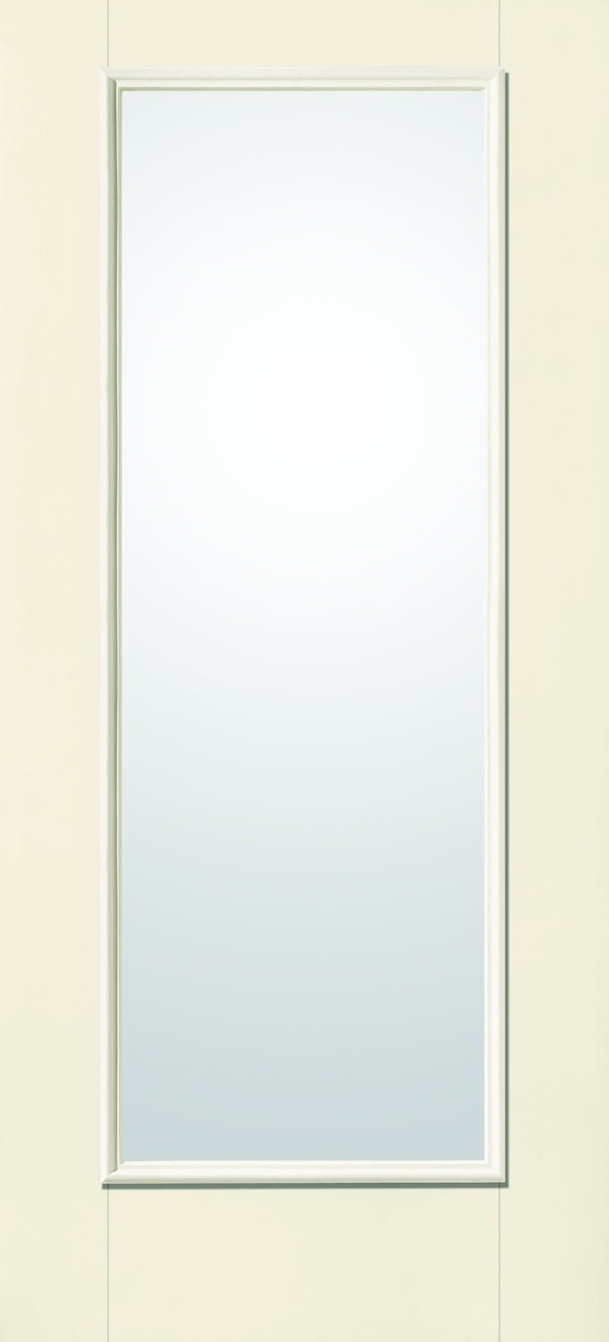
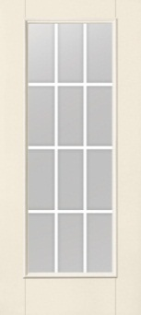
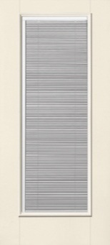
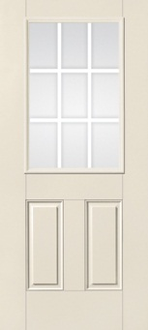
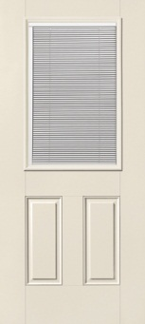
Your Logo Here
Smooth-Star® Paintable Fiberglass Doors
Patio Doors
Smooth-Star
Clear Glass
(Standard)
6'8" Door – S118
Smooth-Star
Clear Glass with Grilles Between Glass
(Option)
6'8" Door – S1208
Smooth Star
Clear Glass with Internal Blinds
(Option)
6'8" Door – S130
Side Doors
Light control at your fingertips: Internal blinds provide the privacy and convenience of a cordless blind enclosed between glass. A single-handed operator opens, closes and tilts the blinds to control the desired level of privacy and light. Low-E glass option available.
Smooth-Star
Solid 6-Panel Door
(Standard)
6'8" Door – S210
Smooth-Star
Clear Glass with Grilles Between Glass
(Option)
6'8" Door – S262
Smooth-Star
Clear Glass with Internal Blinds
(Option)
6'8" Door – S132
Note: Product images show exterior side of door. Colors may vary from an actual application due to fluctuations in finishing. Glass privacy ratings may be more or less than indicated, based on glass design and size of glass. Glass designs may differ from depiction due to handcrafting and size of glass. See your Therma-Tru seller or visit www.thermatru.com for details on limited warranties and exclusions, glass privacy ratings and designs, and ENERGY STAR® qualified products.
www.thermatru.com
©2014 Therma-Tru Corp. All rights reserved. ENERGY STAR is a government program that helps consumers protect the environment through superior energy efficiency and is a registered trademark of the U.S. Department of Energy and the U.S. Environmental Protection Agency.
Fiberglass

Slide 3

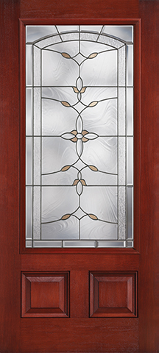

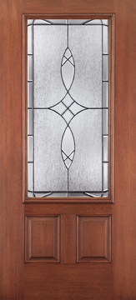

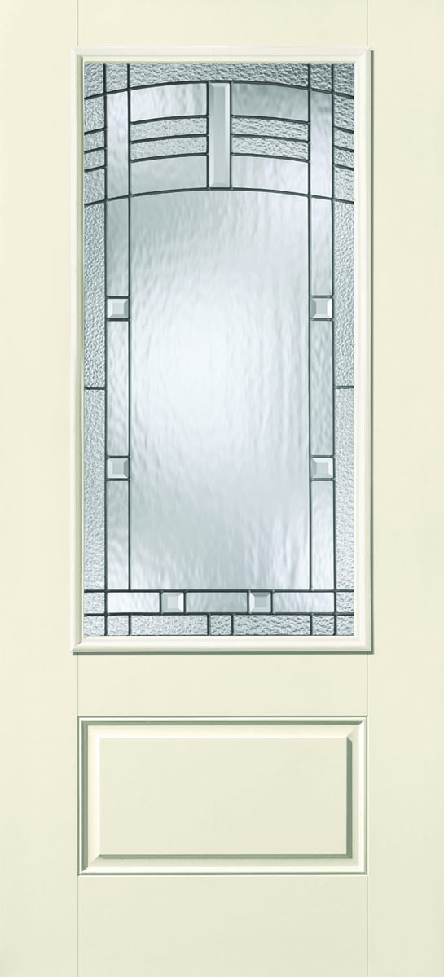


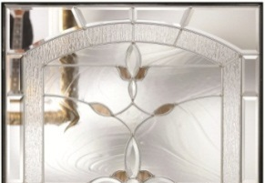
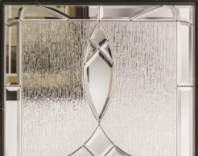
Your Logo Here
Classic-Craft® Fiber-Classic® Smooth-Star®
Mahogany Collection™ Mahogany Collection™
Bella Bronze Waterglass
(Black Nickel or Brushed Nickel Caming)
6'8" Door w/ 14" Sidelites
Door: CCM210B; Sidelites: CCM3310BSL
Blackstone Glass
(Black Nickel or Brushed Nickel Caming)
6'8" Door w/ 14" Sidelites
Door: FCM765; Sidelites: FCM808SL
Maple Park Glass
(Black Nickel or Brushed Nickel Caming)
6'8" Door w/ 14" Sidelites
Door: S6103; Sidelites: S6102SL
Glass Privacy Rating
Glass Privacy Rating
Brushed Nickel
Black Nickel
Glass Privacy Rating
Brushed Nickel
Black Nickel
Note: Product images show exterior side of door. Colors may vary from an actual application due to fluctuations in finishing. Glass privacy ratings may be more or less than indicated, based on glass design and size of glass. Glass designs may differ from depiction due to handcrafting and size of glass. See your Therma-Tru seller or visit www.thermatru.com for details on limited warranties and exclusions, glass privacy ratings and designs, and ENERGY STAR® qualified products.
www.thermatru.com
Optional
©2014 Therma-Tru Corp. All rights reserved. ENERGY STAR is a government program that helps consumers protect the environment through superior energy efficiency and is a registered trademark of the U.S. Department of Energy and the U.S. Environmental Protection Agency.
Fiberglass

Slide 4

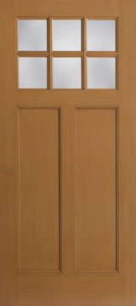

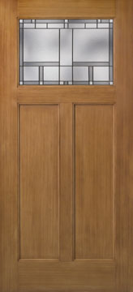
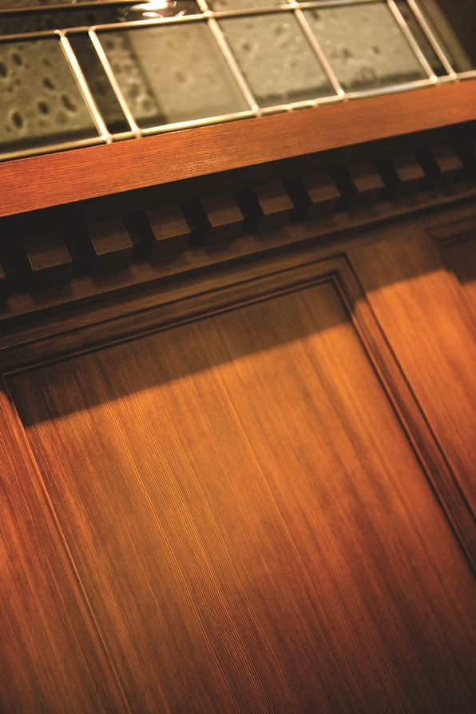

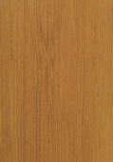
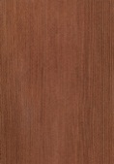
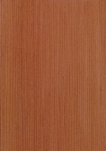
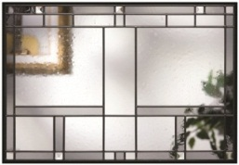
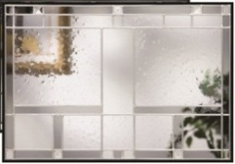

Your Logo Here
Classic-Craft Premium Entryways ̶ American Style CollectionTM
The simple vertical lines and Shaker-style recessed panels of Classic-Craft American Style premium fiberglass entryways create a timeless look perfect for Craftsman-inspired Cottage- and Bungalow-style homes.
Clear Low-E Glass
6'8" Door CCA260 w/ 14" Sidelites CCA220SL
Homeward™ Glass
6'8" Door CCA211 w/ 14" Sidelites CCA211SL
Optional Dentil Shelf
Same-Day® Stain Finish Colors
Black Nickel
Brushed Nickel
4-Block Dentil Shelf
16-Block Dentil Shelf
Natural Oak
Mahogany
Cedar
Note: Product images show exterior side of door. Colors may vary from an actual application due to fluctuations in finishing. Glass privacy ratings may be more or less than indicated, based on glass design and size of glass. Glass designs may differ from depiction due to handcrafting and size of glass. See your Therma-Tru seller or visit www.thermatru.com for details on limited warranties and exclusions, glass privacy ratings and designs, and ENERGY STAR® qualified products.
www.thermatru.com
©2014 Therma-Tru Corp. All rights reserved. ENERGY STAR is a government program that helps consumers protect the environment through superior energy efficiency and is a registered trademark of the U.S. Department of Energy and the U.S. Environmental Protection Agency.
Fiberglass

