Slide 1

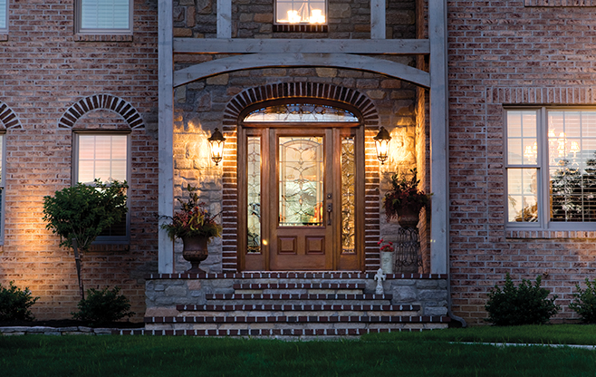
Your Logo Here
Always Make A Great Entrance.
Entry & Patio Door Systems Presented By
(Name) John Builder | (Phone) XXX-XXX-XXXX | (Email) builder@buildername.com | (Web) www.buildername.com
Increase Curb
Appeal & Value
We all want to get the most out of every dollar we spend, and installing an attractive front entrance is a cost-effective way to improve your home’s curb appeal and perceived value. In fact, a study conducted by an independent research company found that a home with an enhanced Therma-Tru® entry door system added to its perceived value by as much as five times the cost of the door itself.*
Right click – Open Hyperlink:
Insert picture of builder's home or choose from Therma-Tru's beauty shots here.
Optional: (Name) John Builder | (Phone) XXX-XXX-XXXX | (Email) builder@buildername.com | (Web) www.buildername.com
*Therma-Tru’s “National Home Valuation Study” was commissioned by Therma-Tru in 2002 and conducted by TNS, an independent provider of internet-based research and research-based marketing information and counsel.
©2014 Therma-Tru Corp. All rights reserved.
www.thermatru.com

Slide 2
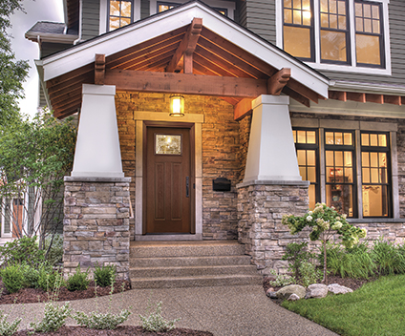


Your Logo Here
Therma-Tru. You’re in Expert Hands.
Backed by our lifetime limited warranty.
Lifetime Limited Warranty
We stand behind more parts of a door system for longer than other door companies because we make or specify everything that goes into it. A Therma-Tru fiberglass door system is backed by the industry’s most comprehensive lifetime limited warranty.
Energy Efficiency
In any region or climate, energy efficiency is key. Thousands of Therma-Tru door and glass options are ENERGY STAR® qualified and National Fenestration Rating Council (NFRC) certified, helping save money on energy costs.
Quality Testing
Our doors, glass and components are held to high standards. We conduct thorough testing to guarantee that our products will live up to a homeowner’s toughest quality and performance expectations.
Right click – Open Hyperlink:
Insert picture of builder's home or choose from Therma-Tru's beauty shots here.
(Name) John Builder | (Phone) XXX-XXX-XXXX | (Email) builder@buildername.com | (Web) www.buildername.com
Note: See your Therma-Tru seller or visit www.thermatru.com for details on limited warranties and exclusions, and ENERY STAR qualified products.
©2014 Therma-Tru Corp. All rights reserved.
www.thermatru.com

Slide 3
Your Logo Here
Headline
Subhead
Door Family
Door / Glass Description
Caming
6'8" / 8'0" Door – Style #
Note: Product images show exterior side of door. Colors may vary from an actual application due to fluctuations in finishing. Glass privacy ratings may be more or less than indicated, based on glass design and size of glass. Glass designs may differ from depiction due to handcrafting and size of glass. See your Therma-Tru seller or visit www.thermatru.com for details on limited warranties and exclusions, glass privacy ratings and designs, and ENERGY STAR® qualified products.
www.thermatru.com
©2014 Therma-Tru Corp. All rights reserved. ENERGY STAR is a government program that helps consumers protect the environment through superior energy efficiency and is a registered trademark of the U.S. Department of Energy and the U.S. Environmental Protection Agency.
Fiberglass

Slide 4
Your Logo Here
Headline
Subhead
Door Family
Door / Glass Description
Caming
6'8" / 8'0" Door – Style #
Door Family
Door / Glass Description
Caming
6'8" / 8'0" Door – Style #
Door Family
Door / Glass Description
Caming
6'8" / 8'0" Door – Style #
Note: Product images show exterior side of door. Colors may vary from an actual application due to fluctuations in finishing. Glass privacy ratings may be more or less than indicated, based on glass design and size of glass. Glass designs may differ from depiction due to handcrafting and size of glass. See your Therma-Tru seller or visit www.thermatru.com for details on limited warranties and exclusions, glass privacy ratings and designs, and ENERGY STAR® qualified products.
www.thermatru.com
©2014 Therma-Tru Corp. All rights reserved. ENERGY STAR is a government program that helps consumers protect the environment through superior energy efficiency and is a registered trademark of the U.S. Department of Energy and the U.S. Environmental Protection Agency.
Fiberglass

Slide 5
Your Logo Here
Headline
Subhead
Door Family
Door / Glass Description
Caming
6'8" / 8'0" Door – Style #
Door Family
Door / Glass Description
Caming
6'8" / 8'0" Door – Style #
Door Family
Door / Glass Description
Caming
6'8" / 8'0" Door – Style #
Door Family
Door / Glass Description
Caming
6'8" / 8'0" Door – Style #
Door Family
Door / Glass Description
Caming
6'8" / 8'0" Door – Style #
Door Family
Door / Glass Description
Caming
6'8" / 8'0" Door – Style #
Note: Product images show exterior side of door. Colors may vary from an actual application due to fluctuations in finishing. Glass privacy ratings may be more or less than indicated, based on glass design and size of glass. Glass designs may differ from depiction due to handcrafting and size of glass. See your Therma-Tru seller or visit www.thermatru.com for details on limited warranties and exclusions, glass privacy ratings and designs, and ENERGY STAR® qualified products.
www.thermatru.com
©2014 Therma-Tru Corp. All rights reserved. ENERGY STAR is a government program that helps consumers protect the environment through superior energy efficiency and is a registered trademark of the U.S. Department of Energy and the U.S. Environmental Protection Agency.
Fiberglass

Slide 6
Your Logo Here
Classic-Craft® Collection
Subhead
Door Family
Door / Glass Description
Caming
6'8" / 8'0" Door – Style #
Note: Product images show exterior side of door. Colors may vary from an actual application due to fluctuations in finishing. Glass privacy ratings may be more or less than indicated, based on glass design and size of glass. Glass designs may differ from depiction due to handcrafting and size of glass. See your Therma-Tru seller or visit www.thermatru.com for details on limited warranties and exclusions, glass privacy ratings and designs, and ENERGY STAR® qualified products.
www.thermatru.com
©2014 Therma-Tru Corp. All rights reserved. ENERGY STAR is a government program that helps consumers protect the environment through superior energy efficiency and is a registered trademark of the U.S. Department of Energy and the U.S. Environmental Protection Agency.
Fiberglass

Slide 7
Your Logo Here
Classic-Craft® Collection
Subhead
Door Family
Door / Glass Description
Caming
6'8" / 8'0" Door – Style #
Door Family
Door / Glass Description
Caming
6'8" / 8'0" Door – Style #
Door Family
Door / Glass Description
Caming
6'8" / 8'0" Door – Style #
Note: Product images show exterior side of door. Colors may vary from an actual application due to fluctuations in finishing. Glass privacy ratings may be more or less than indicated, based on glass design and size of glass. Glass designs may differ from depiction due to handcrafting and size of glass. See your Therma-Tru seller or visit www.thermatru.com for details on limited warranties and exclusions, glass privacy ratings and designs, and ENERGY STAR® qualified products.
www.thermatru.com
©2014 Therma-Tru Corp. All rights reserved. ENERGY STAR is a government program that helps consumers protect the environment through superior energy efficiency and is a registered trademark of the U.S. Department of Energy and the U.S. Environmental Protection Agency.
Fiberglass

Slide 8
Your Logo Here
Classic-Craft® Collection
Subhead
Door Family
Door / Glass Description
Caming
6'8" / 8'0" Door – Style #
Door Family
Door / Glass Description
Caming
6'8" / 8'0" Door – Style #
Door Family
Door / Glass Description
Caming
6'8" / 8'0" Door – Style #
Door Family
Door / Glass Description
Caming
6'8" / 8'0" Door – Style #
Door Family
Door / Glass Description
Caming
6'8" / 8'0" Door – Style #
Door Family
Door / Glass Description
Caming
6'8" / 8'0" Door – Style #
Note: Product images show exterior side of door. Colors may vary from an actual application due to fluctuations in finishing. Glass privacy ratings may be more or less than indicated, based on glass design and size of glass. Glass designs may differ from depiction due to handcrafting and size of glass. See your Therma-Tru seller or visit www.thermatru.com for details on limited warranties and exclusions, glass privacy ratings and designs, and ENERGY STAR® qualified products.
www.thermatru.com
©2014 Therma-Tru Corp. All rights reserved. ENERGY STAR is a government program that helps consumers protect the environment through superior energy efficiency and is a registered trademark of the U.S. Department of Energy and the U.S. Environmental Protection Agency.
Fiberglass

Slide 9
Your Logo Here
Fiber-Classic® / Smooth-Star®
Subhead
Door Family
Door / Glass Description
Caming
6'8" / 8'0" Door – Style #
Note: Product images show exterior side of door. Colors may vary from an actual application due to fluctuations in finishing. Glass privacy ratings may be more or less than indicated, based on glass design and size of glass. Glass designs may differ from depiction due to handcrafting and size of glass. See your Therma-Tru seller or visit www.thermatru.com for details on limited warranties and exclusions, glass privacy ratings and designs, and ENERGY STAR® qualified products.
www.thermatru.com
©2014 Therma-Tru Corp. All rights reserved. ENERGY STAR is a government program that helps consumers protect the environment through superior energy efficiency and is a registered trademark of the U.S. Department of Energy and the U.S. Environmental Protection Agency.
Fiberglass

Slide 10
Your Logo Here
Fiber-Classic® / Smooth-Star®
Subhead
Door Family
Door / Glass Description
Caming
6'8" / 8'0" Door – Style #
Door Family
Door / Glass Description
Caming
6'8" / 8'0" Door – Style #
Door Family
Door / Glass Description
Caming
6'8" / 8'0" Door – Style #
Note: Product images show exterior side of door. Colors may vary from an actual application due to fluctuations in finishing. Glass privacy ratings may be more or less than indicated, based on glass design and size of glass. Glass designs may differ from depiction due to handcrafting and size of glass. See your Therma-Tru seller or visit www.thermatru.com for details on limited warranties and exclusions, glass privacy ratings and designs, and ENERGY STAR® qualified products.
www.thermatru.com
©2014 Therma-Tru Corp. All rights reserved. ENERGY STAR is a government program that helps consumers protect the environment through superior energy efficiency and is a registered trademark of the U.S. Department of Energy and the U.S. Environmental Protection Agency.
Fiberglass

Slide 11
Your Logo Here
Fiber-Classic® / Smooth-Star®
Subhead
Door Family
Door / Glass Description
Caming
6'8" / 8'0" Door – Style #
Door Family
Door / Glass Description
Caming
6'8" / 8'0" Door – Style #
Door Family
Door / Glass Description
Caming
6'8" / 8'0" Door – Style #
Door Family
Door / Glass Description
Caming
6'8" / 8'0" Door – Style #
Door Family
Door / Glass Description
Caming
6'8" / 8'0" Door – Style #
Door Family
Door / Glass Description
Caming
6'8" / 8'0" Door – Style #
Note: Product images show exterior side of door. Colors may vary from an actual application due to fluctuations in finishing. Glass privacy ratings may be more or less than indicated, based on glass design and size of glass. Glass designs may differ from depiction due to handcrafting and size of glass. See your Therma-Tru seller or visit www.thermatru.com for details on limited warranties and exclusions, glass privacy ratings and designs, and ENERGY STAR® qualified products.
www.thermatru.com
©2014 Therma-Tru Corp. All rights reserved. ENERGY STAR is a government program that helps consumers protect the environment through superior energy efficiency and is a registered trademark of the U.S. Department of Energy and the U.S. Environmental Protection Agency.
Fiberglass

